Slide 1
2024 September 1
Session 8
Python Programming with Django
Muhammad Rehan Akhtar

Slide 2
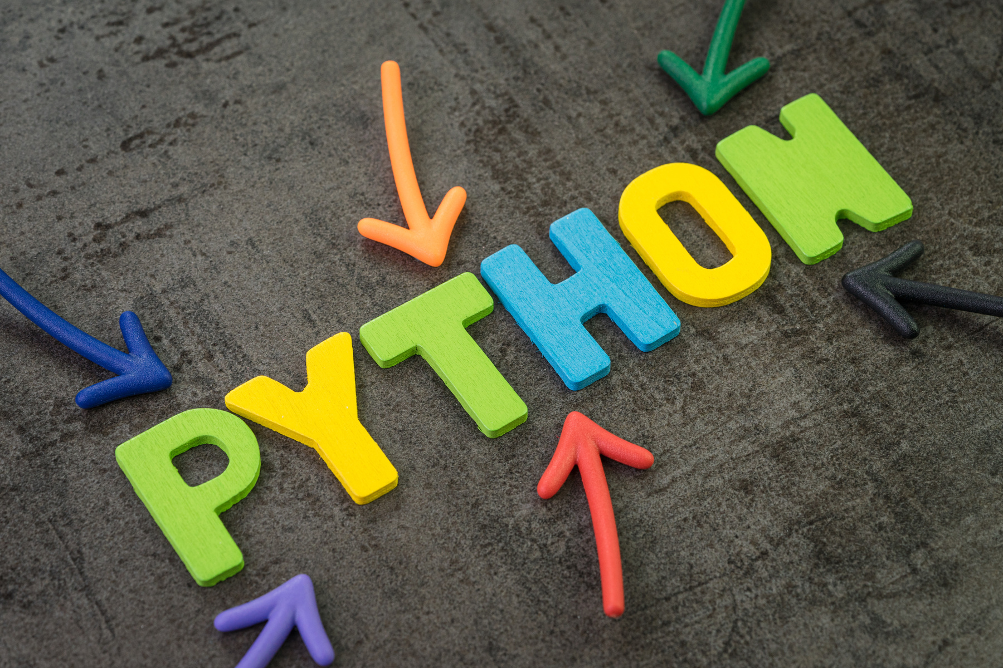




Agenda
1. what is OOP
2. Four Pillar of OOP
3.How to create class and its object
4. Type of Variable in OOP
5.Type of method in OOP
6. Inheritance in OOP
7. Polymorphism in OOP
4

Slide 3
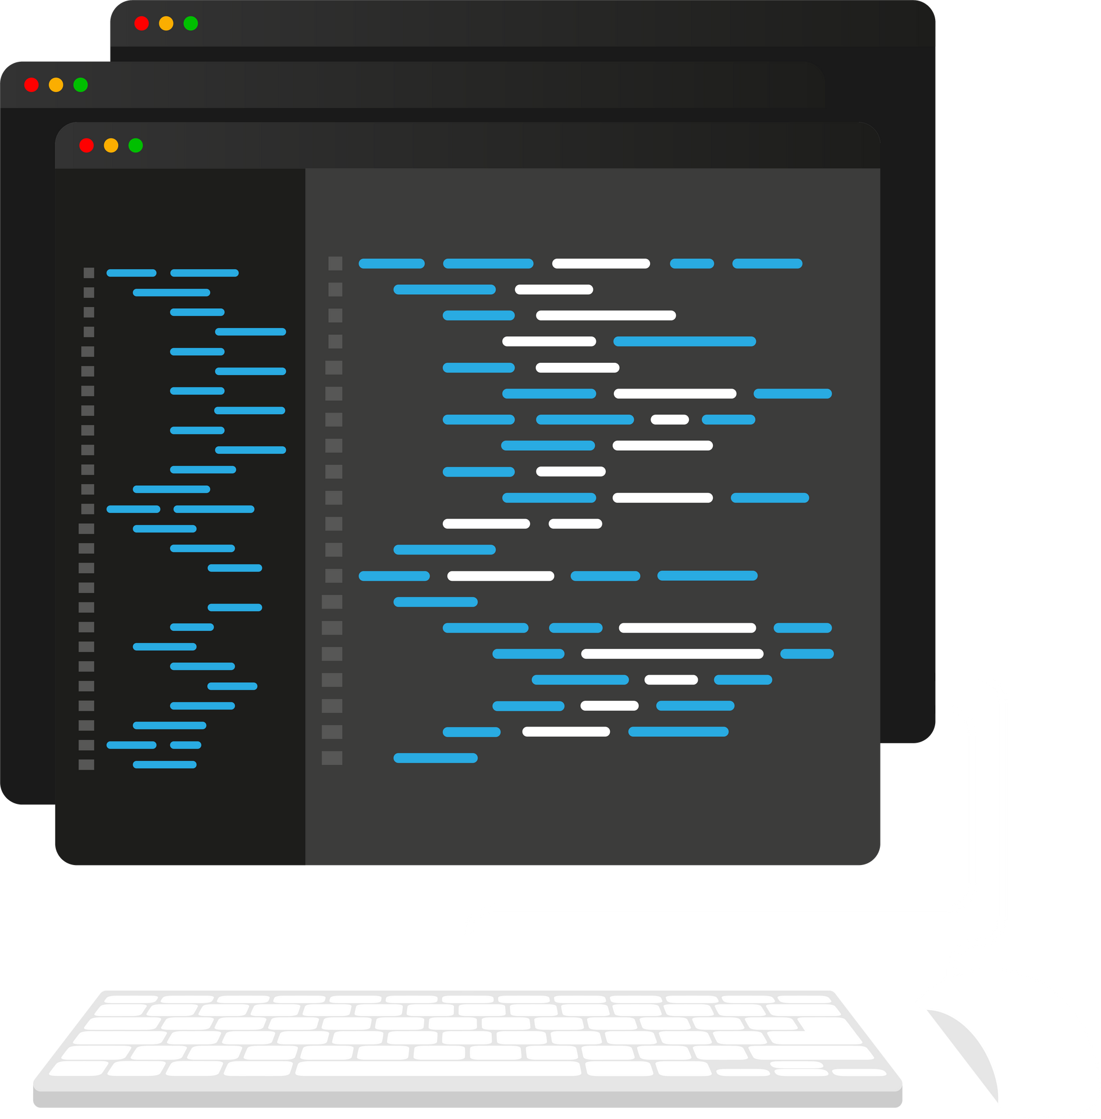
OOP
OOP is not a programming language
OOP is not a programming Tool or Software
It just a model use to write code
OOP is used by many language
key notes
OOP is one of the Popular approach to solve a programming problem is by creating Object
Concept of OOP focus on creating reuseable code.This concept is know as DRY (Do’nt Repeat Yourself)

Slide 4

Four Pillar Of OOP
Encapsulation
Abstraction
Inheritance
Polymorphism

Slide 5
Encapsulation
An act combing properties and method related to the same object is know as encapsulation.

Slide 6
Abstraction
Abstraction is one the key concept of object oriented programming
Its main goal is to handle complexity by hiding unnecessary details from user.

Slide 7
Inheritance
Inheritance allows us to define a class that inherits all the methods and properties from another class. Parent class is the class being inherited from, also called base class. Child class is the class that inherits from another class, also called derived class.

Slide 8
Polymorphism
The word "polymorphism" means "many forms", and in programming it refers to methods/functions/operators with the same name that can be executed on many objects or classes..

Slide 9

Type of Variable in OOP
Global variable
Local variable
Instance Object variable
Class Object variable

Slide 10
Type of method in OOP
Instance Function/Method
Static Method
Class Method
Non member Function

Slide 11
Inheritance in OOP
Single inheritance
Multilevel inheritance
Hierarchical Inheritance
Multiple inheritance

Slide 12
Overiding and Oerloading in OOP
Method Overriding
Method Overloading
Operator Overloading

Slide 13
2024 September 1
Thank you
for listening!
Python Programming with Django
Muhammad Rehan Akhtar

